Slide 1
Weekly report: Foundations
Week number: 12
Date: 16/12/2025
Supervisor: Prof. Dr.-Ing. Torsten Faber
Group members : Jehad Albaali- Amgad Gerges - Reda Deif
presented by : Jehad Albaali

Slide 2
List of contents
Seismic Analysis Parameters
Seismic Forces & Moments
Global Stability Verification
Soil-Structure Interaction Analysis
3D Modeling
References
16/12/2025
Jehad Albaali
Foundations team/ Optimus Syria

Slide 3
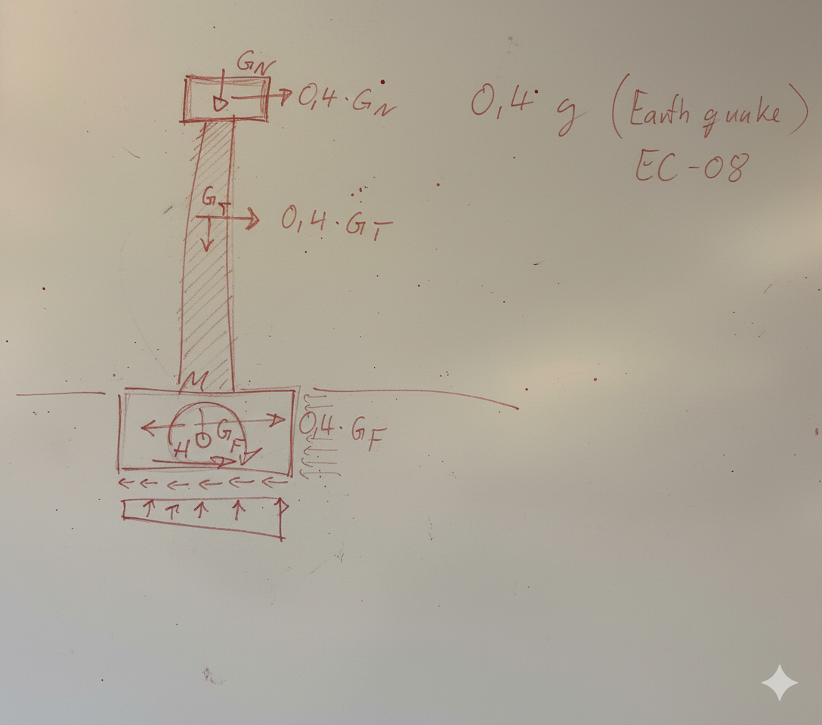
Seismic Analysis Parameters
Design Methodology
The analysis employs the Equivalent Static Force Method (Pseudo-Static approach) in accordance with Eurocode 8 standards. This simplified method is appropriate for regular structures and provides conservative results for seismic design verification.
Seismic Coefficient: a_g=0.4g
This represents a high seismic zone classification, requiring rigorous stability verification across all failure modes.
Figure : by Dr faber
16/12/2025
Jehad Albaali
Foundations team/ Optimus Syria

Slide 4
  Seismic Forces & Moments
Applying the seismic coefficient (0.4) to the precise structural weights yields the following demand on the structure:
Component
Weight (G)
Seismic Force
Lever Arm (H)
Nacelle
146.3 tons
58.5 tons
100.0 m
Tower
349.0 tons
139.6 tons
50.0 m
Foundation
2,856.0 tons
1,142.4 tons
1.0 m
TOTAL (Demand)
3,351.3 tons
1,340.5 tons
—
1,340
14K
Base Shear
Overturning Moment
Total horizontal force in tons
Total moment in ton·m
The seismic force calculation follows V_i = 0.4 \times G for each component, with forces applied at respective centers of gravity to determine the total base shear and overturning moment acting on the foundation.
16/12/2025
Jehad Albaali
Foundations team/ Optimus Syria

Slide 5
Global Stability Verification
Two critical stability checks ensure the foundation remains secure under seismic loading conditions. Both checks demonstrate adequate safety factors exceeding minimum code requirements.
1
2
Sliding Stability Check
Overturning Stability Check
This check verifies that horizontal seismic forces do not cause the foundation to slide across the soil interface.
This check ensures the foundation weight provides sufficient resistance against rotational failure.
Resisting Force (Friction + Cohesion): 2,372 tons (23,295 kN)
Stabilizing Moment (Weight × Radius): 41,891 ton·m (315,800 kN·m)
Driving Shear Force: 1,340 tons (13,158 kN)
Overturning Moment: ~13,972 ton·m (137,133 kN·m)
Factor of Safety: 1.77 > 1.0 → SAFE
Factor of Safety: 2.30 > 1.0 → SAFE
The resisting forces, generated through friction between the foundation base and soil plus soil cohesion, significantly exceed the applied horizontal seismic force.
The stabilizing moment from the foundation's self-weight provides more than double the resistance needed to prevent overturning.
16/12/2025
Jehad Albaali
Foundations team/ Optimus Syria

Slide 6
Soil-Structure Interaction Analysis
Bearing Capacity Verification
Eccentricity & Gapping Analysis
The bearing pressure check ensures soil beneath the foundation can support the combined static and seismic loads without failure.
Eccentricity measures how far the resultant force shifts from the foundation center, indicating potential edge uplift.
Calculated Eccentricity (e): 5.43 m
Maximum Edge Pressure (q_{max}): 356 kPa
Allowable Dynamic Bearing Capacity: > 400 kPa
Critical Threshold: R/4 = 3.12 m
The allowable capacity assumes compacted fill material with appropriate seismic increase factors per Eurocode 8 provisions.
Foundation Radius (R): 12.5 m
Observation: Since e > R/4, partial gap opening occurs at the foundation edge under peak seismic loading.
Result: Safe against soil failure
The maximum bearing pressure remains below the soil's dynamic capacity, ensuring no bearing failure occurs during seismic loading.
Conclusion: Acceptable under ULS conditions
While edge gapping occurs, global stability is maintained with adequate safety factors. This behavior is acceptable for extreme seismic events at Ultimate Limit State.
16/12/2025
Jehad Albaali
Foundations team/ Optimus Syria

Slide 7
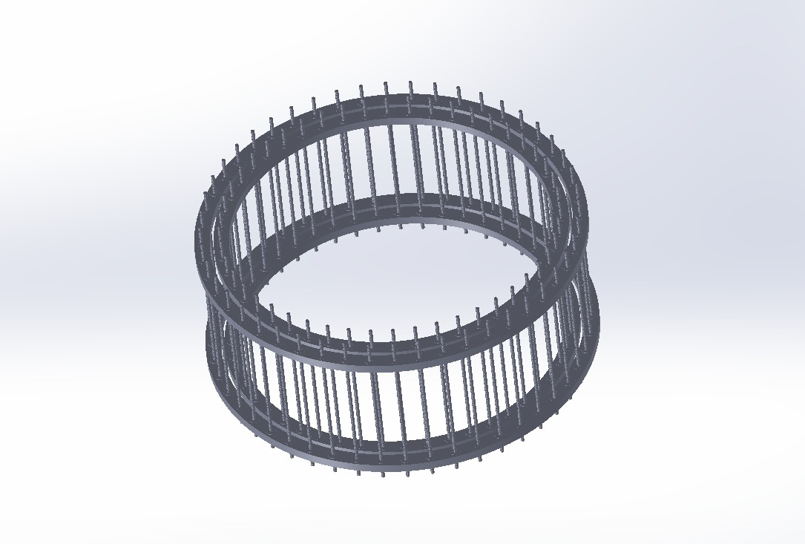
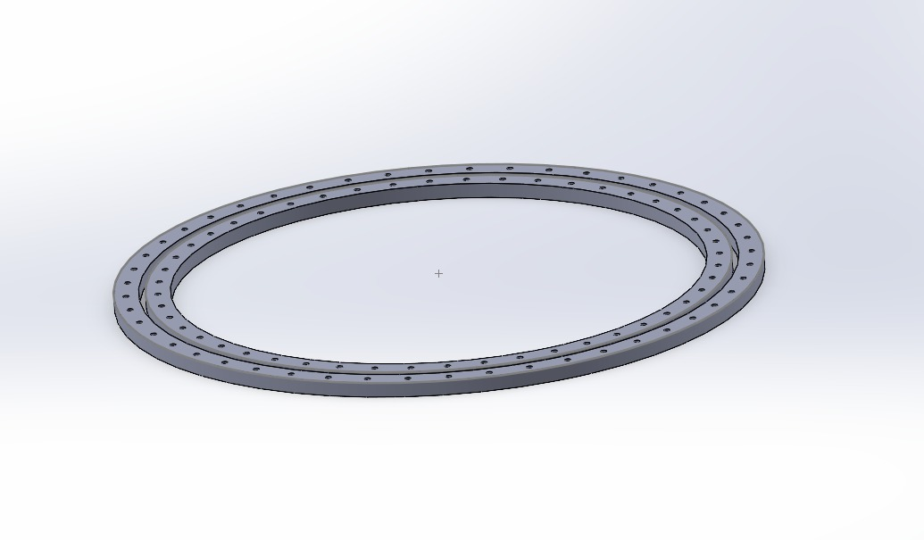
3D Modeling Wind of Turbine Foundation (Anchor cage)
3D model of anchor cage with anchor bolts
Figure created by (Solidwork)
16/12/2025
Jehad Albaali
Foundations team/ Optimus Syria

Slide 8
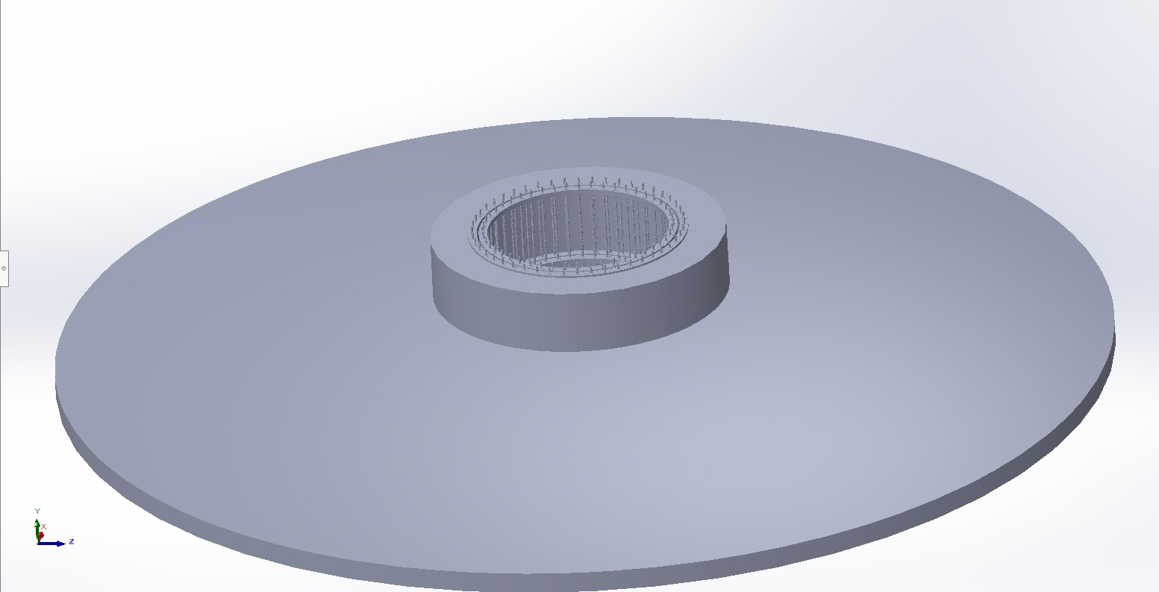
3D Modeling Wind of Turbine Foundation
3D model of wind turbine foundation and pedestal (SolidWorks)
Figure created by the author (Solid work )
16/12/2025
Jehad Albaali
Foundations team/ Optimus Syria

Slide 9
References
EN 1998-1 (Eurocode 8)Design of structures for earthquake resistance – Part 1: General rules, seismic actions and rules for buildings,
EN 1997-1 (Eurocode 7)Geotechnical design – Part 1: General rules,European Committee for Standardization (CEN).
SolidWorks Corporation.SolidWorks User Documentation – 3D Modeling and Assembly,
16/12/2025
Jehad Albaali
Foundations team/ Optimus Syria

